Slide 1
StoryLinks
by Pinnacle

Slide 2
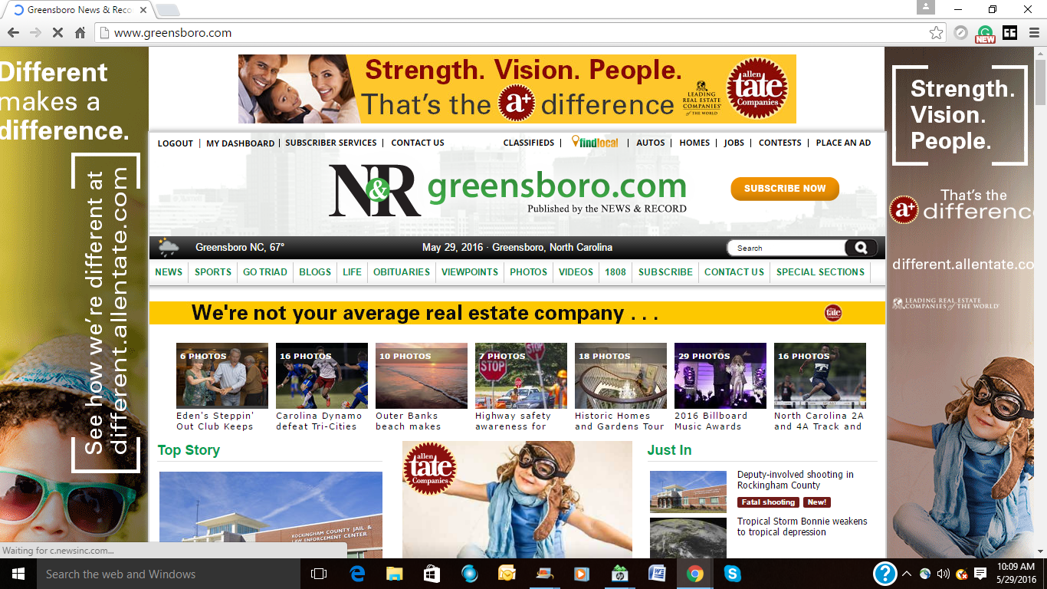
Background
Annoying pop-ups with links to irrelevant sites have been a big problem for publishers and users alike on the internet. In majority of the cases, the links pushed to publisher sites and apps are based on past browsing history of a user and wouldn’t be relevant. These are intrusive and irritating.

Slide 3
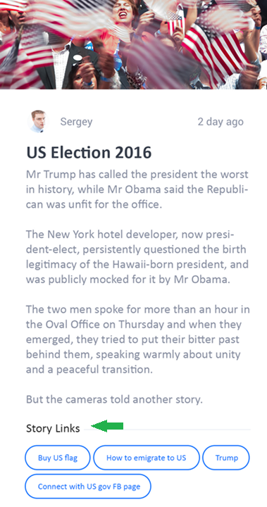
What is StoryLinks
Pinnacle aims to build a platform that addresses this problem by delivering content based links to articles which are un-intrusive, elegant and useful to the user.
Storylinks platform include an admin web portal, a web SDK and a mobile SDK.

Slide 4










How it works
8. StoryLinks share $$ with publisher
7. Supplier pays StoryLinks
1. Web publishing
2. Content is sent to Story Links
Publisher
4. Links are sent back publisher
Supplier
3. NLP and AI processing
1. Mobile publishing
Story Links
6. Redirected to supplier web site
5. Consumer clicks on Storylinks

Slide 5
Business model
Publishers use Storylinks SDK on their sites and mobile apps for free
Storylinks associates with suppliers to gain access to their products and services
Storylinks earns $$ by charging suppliers for hits to their site
Publishers earn a portion of the $$ from Storylinks

Slide 6
Thank you
Q&A

